Slide 1
DATABASE CONNECTION TECHNOLOGY
Presented by: Shalmon Anandas
Guru Nanak Khalsa College of Arts, Science & Commerce (Autonomous)
Department of Bioinformatics
M.Sc Bioinformatics, Part-I

Slide 2
Contents
What is DBMS?
Database Connectivity in Java
Database Connectivity in Python
Database Connectivity in PHP
Conclusion
References

Slide 3
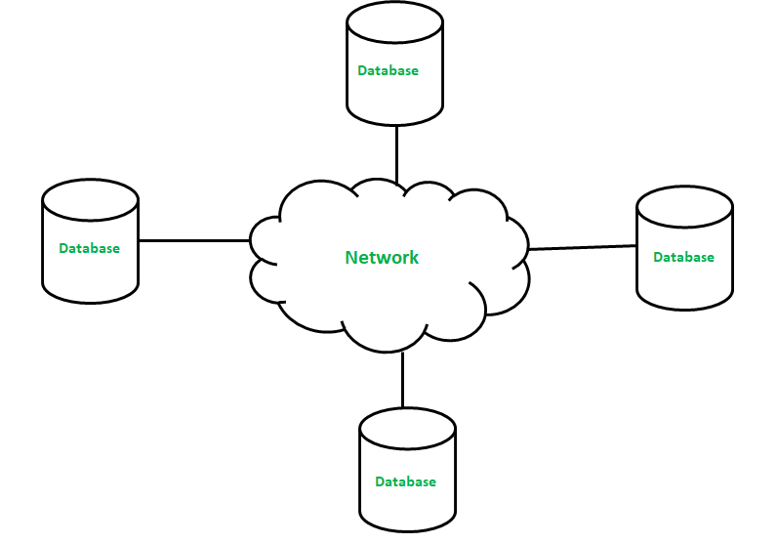
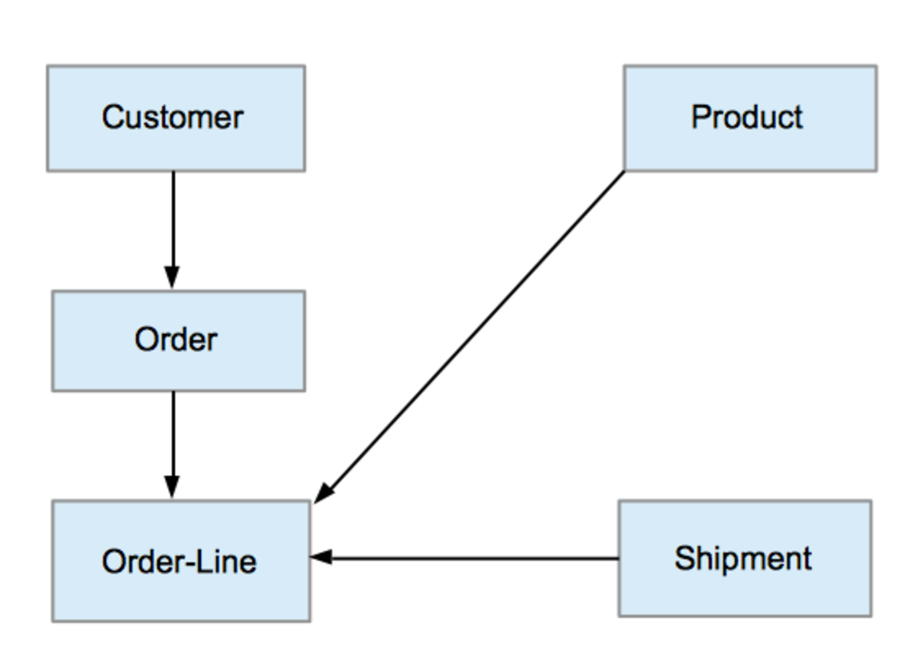
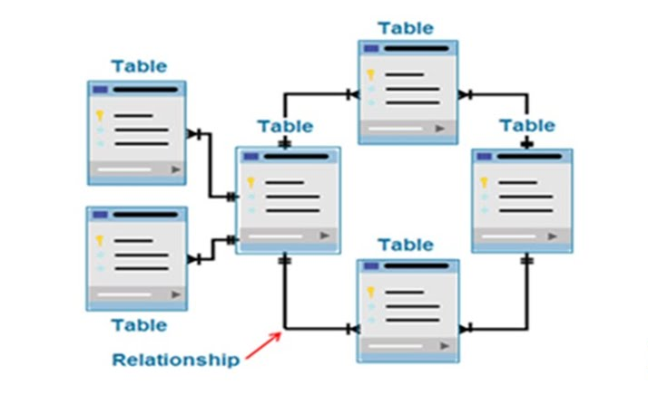
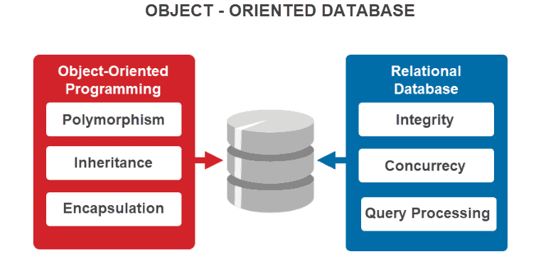
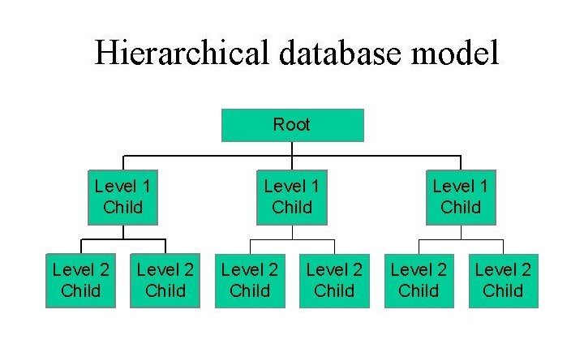
What is DBMS?
Serves as Interface
Types are
Distributed DBMS
Hierarchical DBMS
Network DBMS
Relational DBMS
Object-oriented DBMS

Slide 4
Database Connectivity in Java
What is Java?
Object Oriented Programming language
Syntax derived from C
Functionality derived from C++
Portable
Embeddable
Platform Agnostic

Slide 5
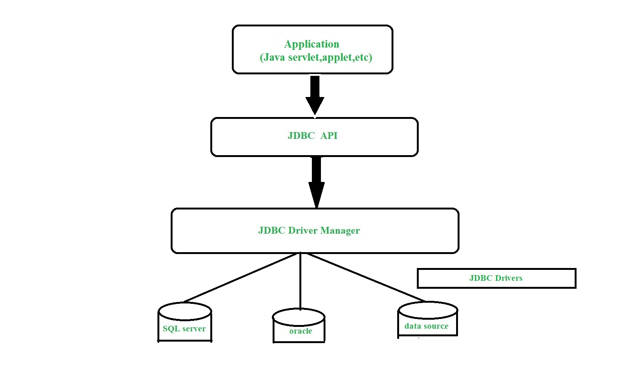
Overview of JBDC
API to access databases
Translator
Various types:
Type 1: JDBC-ODBC
Type 2: Native API
Type 3: Network Protocol
Type 4: Thin Native API

Slide 6
Connecting to Database
Load Driver
Open Connection
Create statement
Return error messages
Terminate connection
Class.forName(com.mysql.cj.jdbc.Driver);
Connection conn = DriverManager.getConnection(url, username, password);
Statement st = con.createStatement();
catch(SQLException se){se.printStackTrace();
conn.close();

Slide 7
Database connectivity in Python
What is Python?
Object Oriented Programming Language
Interpreted
Portable
Syntactically simple

Slide 8
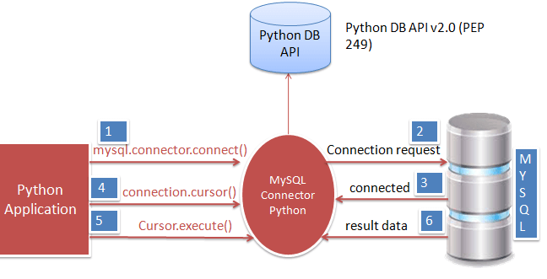
Overview of Database connection in Python

Slide 9
Connecting to Database
import mysql.connector
connection = mysql.connector.connect(host, database, user,password)
cursor = connection.cursor()
cursor.execute("select database();")
record = cursor.fetchall()
Cursor.close() Connection.close()
Import MySQL connector
Use connect() method
Use cursor() method
Use execute() method
Read result using fetchall()
Close cursor() and connect()

Slide 10
Database connection in PHP
What is PHP?
PHP is the backbone of Web 2.0
Service Oriented
Specifically for webapps
Backed by IT giants

Slide 11
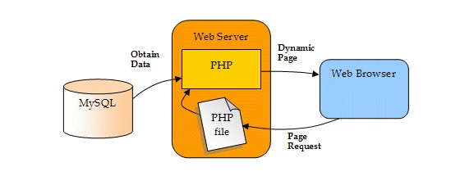
Overview of Database connection in PHP

Slide 12
Connecting to Database
Connected using:
MySQLi (OOP)
MySQLi (Procedural)
PDO
The difference only lies in Syntax
Steps remain the same:
Initiate connection
Check Connection
$conn = mysqli_connect($servername, $username, $password);
if (!$conn) {die("Connection failed: " . mysqli_connect_error());}

Slide 13
COnclusion
Learned how to connect Database to client Side Applications using various technologies

Slide 14
References
Kumari, S., Rani, K. S., & Yadav, M. (2017). Database Connection Techonology. International Journal of Advanced Research in Computer Science, 8(5). https://doi.org/https://doi.org/10.26483/ijarcs.v8i5

